Slide 1
Key influencers

Slide 2
Open the Customer feedback PBIX file in Power BI desktop.

Slide 3
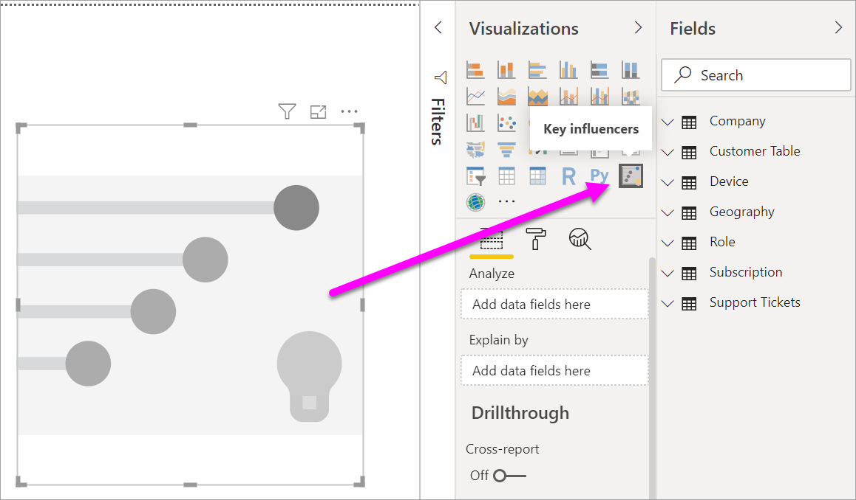
Objective: create the key influencers visualization
Open the report and select the Key influencers icon.
Notes:

Slide 4
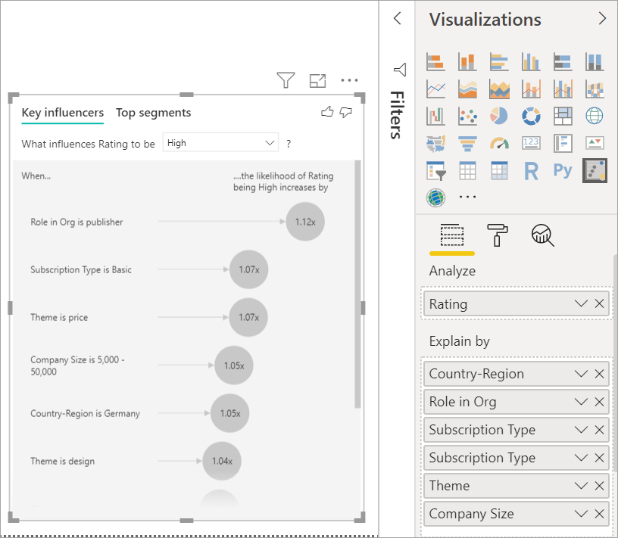
Objective: Setup the key influencers visualization
Move Customer Table > Rating into the Analyze field.
Move fields that you think might influence Rating into the Explain by field. In this case, start with:
Country-Region
Role in Org
Subscription Type
Company Size
Theme
Leave the Expand by field empty. This field is only used when analyzing a measure or summarized field.
Notes:
Notes:
This metric is defined at a customer level.
Each customer has given either a high score or a low score.
All the explanatory factors must be defined at the customer level for the visual to make use of them.

Slide 5
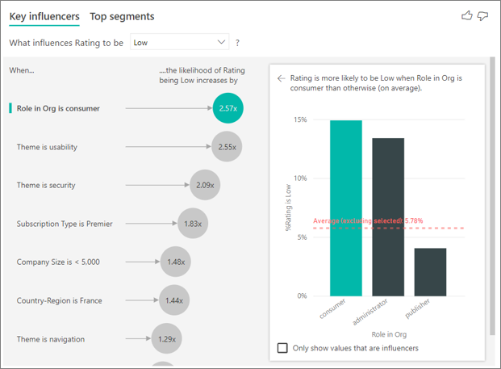
Objective: Interpret key influencers
To focus on the negative ratings, select Low in the What influences Rating to be drop-down box.
Click on the Role in Org is consumer influencer and notice the column chart on the right.
Notes:
Notes:
red dotted line, changed from 5.78% to 11.34%. The average is dynamic because it's based on the average of all other values.

Slide 6
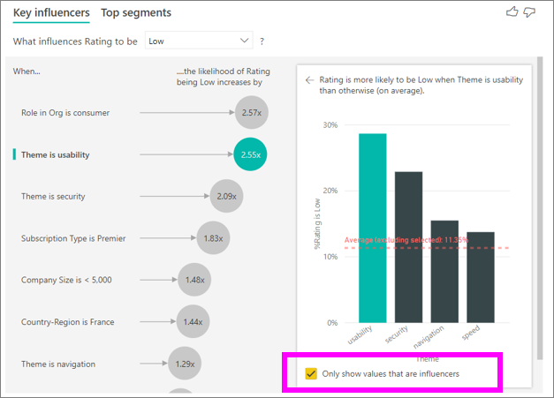
Select the second influencer in the list, which is Theme is usability.
Select the Only show values that are influencers check box to filter by using only the influential values.
Notes:

Slide 7
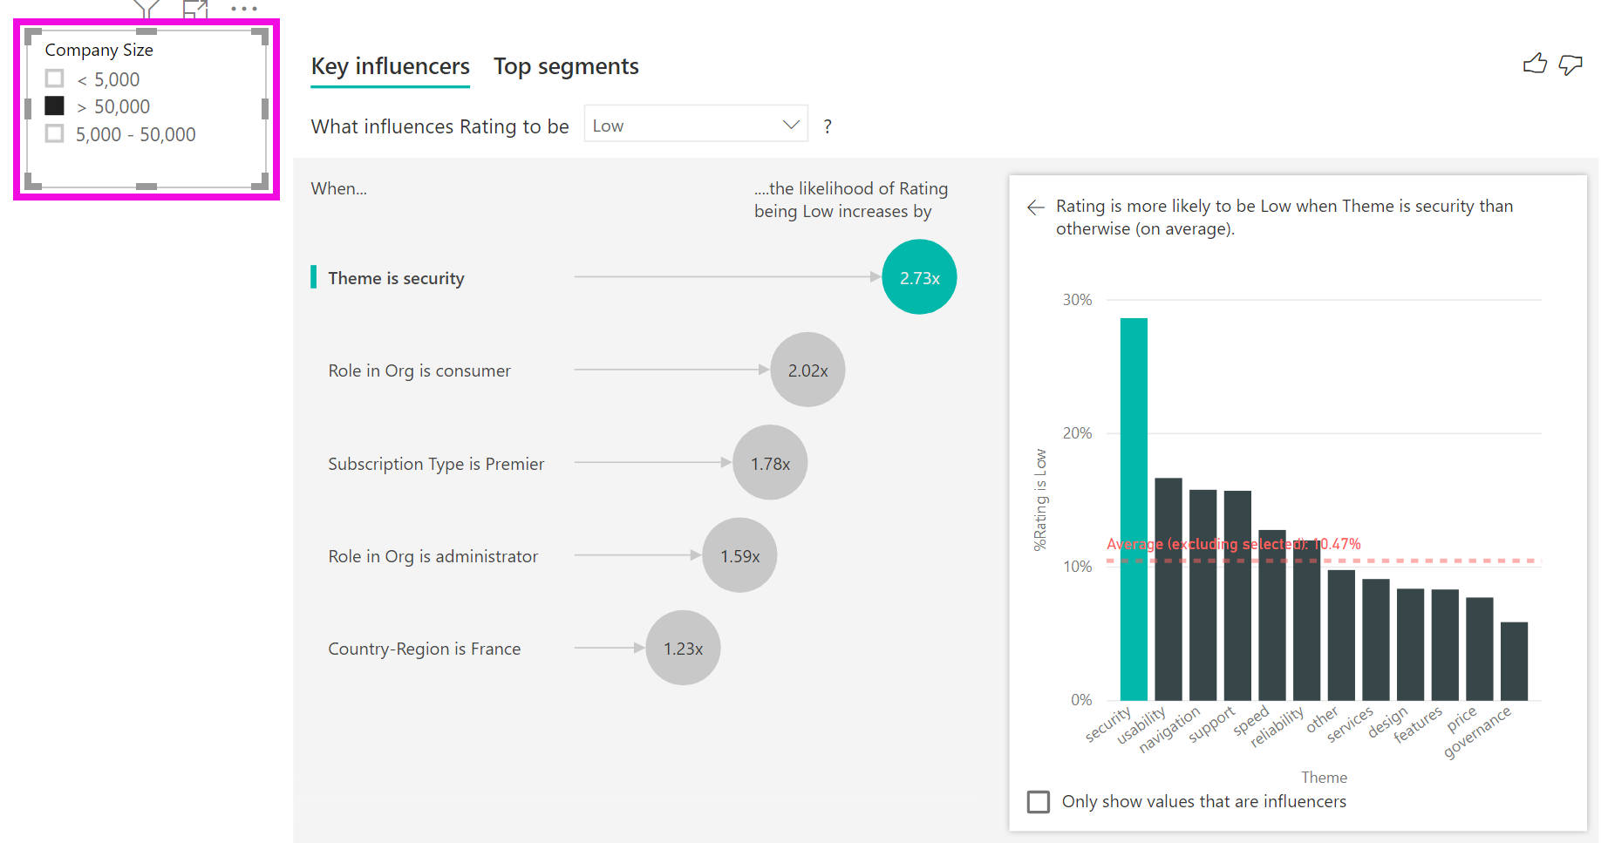
Objective: interact with other visuals
Move Company Size into the report to use it as a slicer.
Select >50,000
Notes:
Notes:
Every time you select a slicer, filter, or other visual on the canvas, the key influencers visual reruns its analysis on the new portion of data.
Use it to see if the key influencers for your enterprise customers are different than the general population
large enterprise customers, the top influencer for low ratings has a theme related to security. You might want to investigate further to see if there are specific security features your large customers are unhappy about.

Slide 8
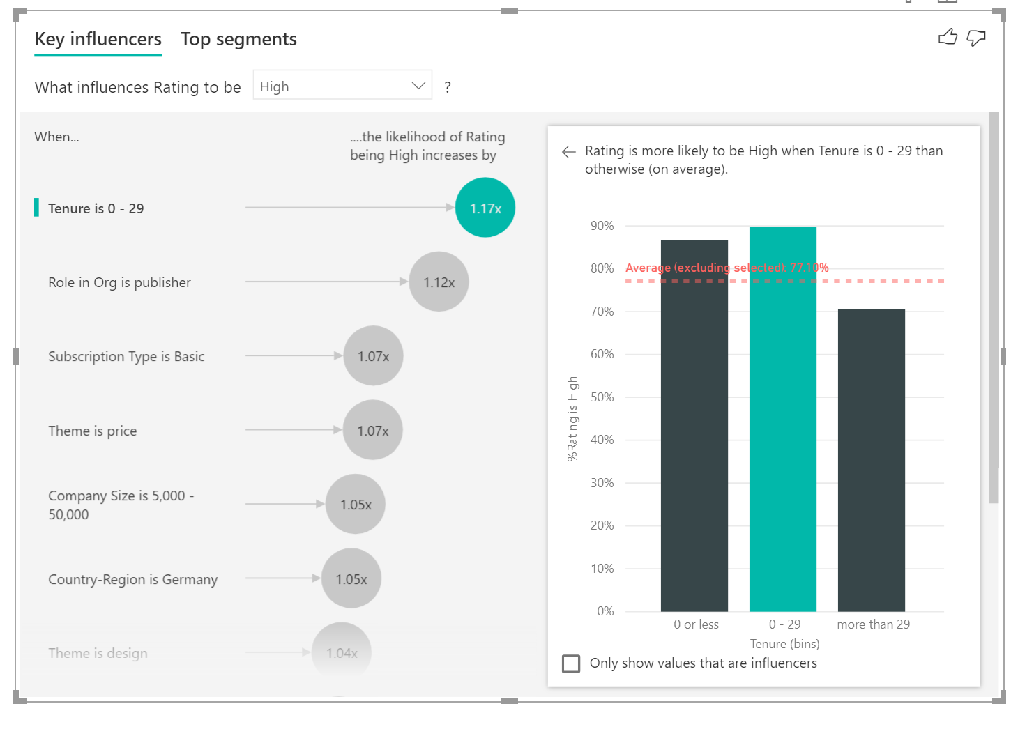
Objective: Continuous key influencers
Move Tenure from the customer table into Explain by.
Notes:
We run correlation tests to determine how linear the influencer is with regards to the target.
If the target is continuous, we run Pearson correlation and if the target is categorical, we run Point Biserial correlation tests.
If we detect the relationship is not sufficiently linear we conduct supervised binning and generate a maximum of 5 bins.
Notes:
It's also possible to have continuous factors such as age, height, and price in the Explain by field.
Tenure depicts how long a customer has used the service.
In some cases you may find that your continuous factors were automatically turned into categorical ones. This is because we realized the relationship between the variables is not linear

Slide 9
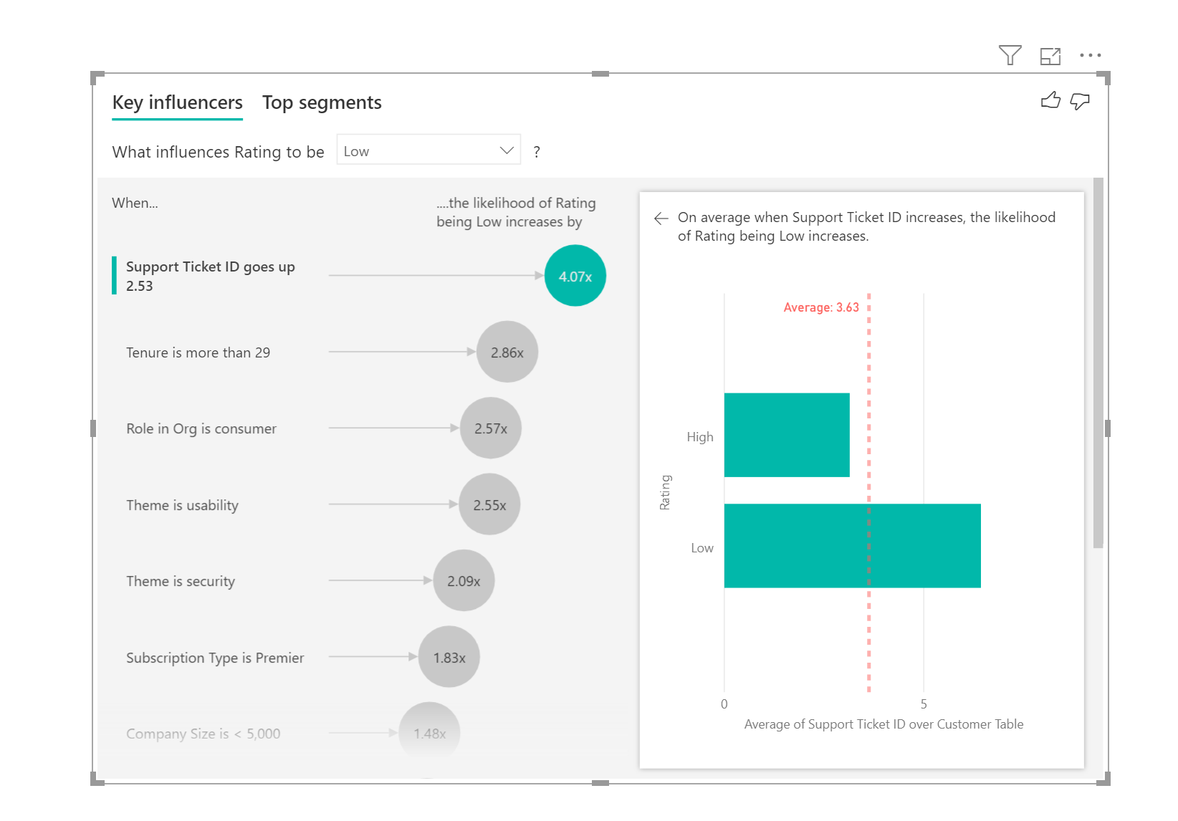
Objective: Interpret measures and aggregates
Now bring in Support Ticket ID from the support ticket table.
Notes:
Notes:
if the number of support tickets that a customer has influences the score they give.
Because a customer can have multiple support tickets, you aggregate the ID to the customer level.
because the analysis runs on the customer level, so all drivers must be defined at that level of granularity.

Slide 10
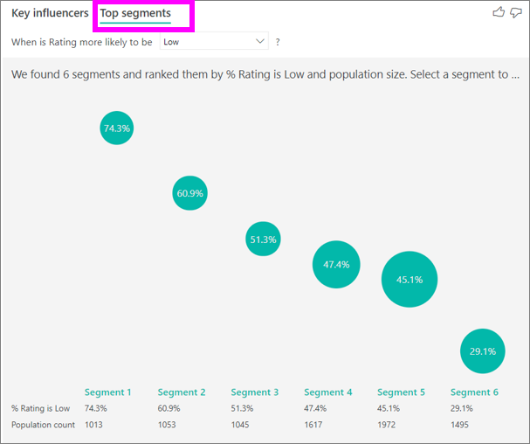
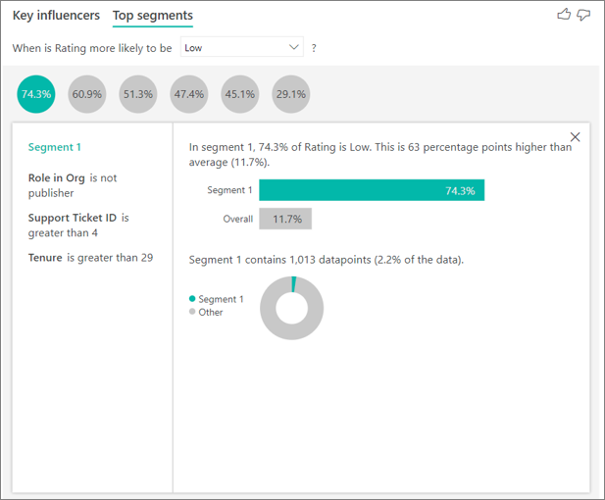
Objective: interpret top segments
Switch to the Top segments tab to see how a combination of factors affects the metric that you're analyzing.
Select the Segment 1 bubble to drill into the details of that segment.
Notes:
see how a combination of factors affects the metric that you're analyzing.
The higher the bubble, the higher the proportion of low ratings.
The size of the bubble represents how many customers are within the segment.

Slide 11
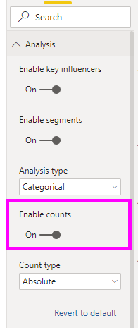
Objective: using counts
Step 1: Go to the Analysis card of the formatting pane and toggle “Enable counts”.
Notes:
Notes:
Sometimes an influencer can have a big impact but represent very little of the data. For example, Theme is usability is the second biggest influencer for low ratings. However there might have only been a handful of customers who complained about usability. Counts can help you prioritize which influencers you want to focus on.

Slide 12
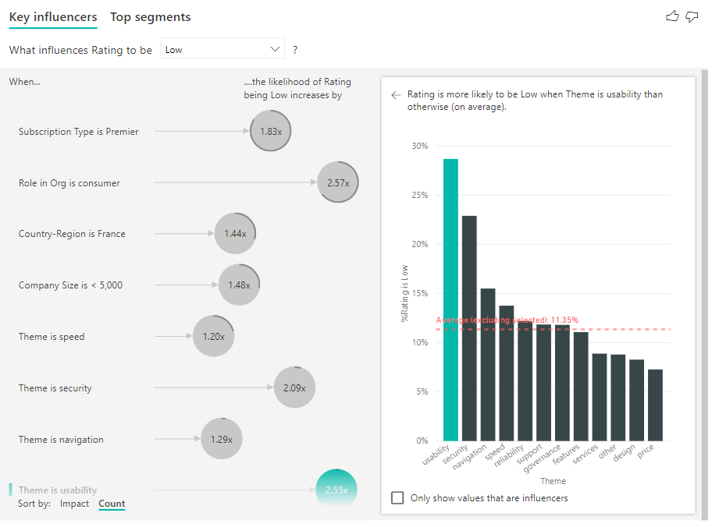
Toggle the Sort by: Count in the bottom left of the visual.
Notes:
Notes:
you’ll see a ring around each influencer’s bubble, which represents the approximate percentage of data that influencer contains. The more of the bubble the ring circles, the more data it contains. We can see that Theme is usability contains a very small proportion of data.

Slide 13
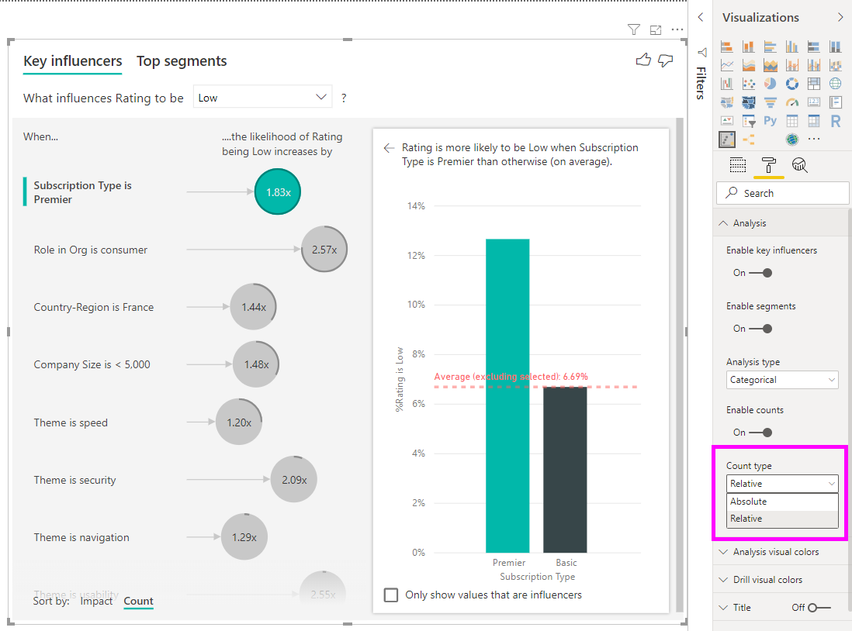
Select Relative in the Count type dropdown in the Analysis card of the formatting pane.
Notes:
Notes:
full ring around the circle means the influencer contains 100% of the data.
change the count type to be relative to the maximum influencer
Now the influencer with the most amount of data will be represented by a full ring and all other counts will be relative to it.

Slide 14
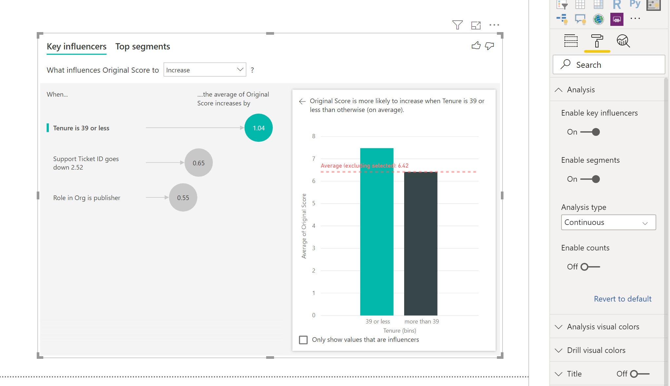
Objective: analyze numeric metric
Drag Original Score field into the Analyze field.
Go to the Formatting Pane and note Continuous Analysis Type.
Notes:
Notes:
unsummarized numerical field into the Analyze field, you have a choice how to handle that scenario - ‘What influences Survey Scores to be 1?, What influences Survey Scores to increase/decrease? This distinction is very helpful when you have lots of unique values in the field you are analyzing.
It is not very meaningful to ask ‘What influences House Price to be 156,214?’ as that is very specific and we are likely not to have enough data to infer a pattern.
Instead we may want to ask, ‘What influences House Price to increase’? which allows us to treat house prices as a range rather than distinct values.

Slide 15
Objective: analyze a measure or a summarized column
Notes:

